Slide 1
CS2030 Lab 5
AY22/23 Sem 2

Slide 2
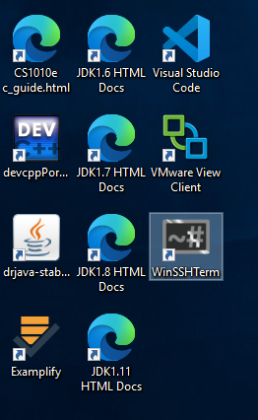
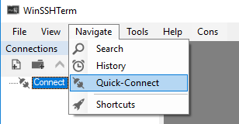
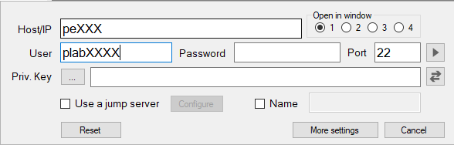
Admin Matters
Please log in to the PE node first!

Slide 3
Deadlines
Please submit your final changes by Sunday 2359
Important: You must get A on CodeCrunch by then in order for the grading to go smoothly
Please note that a re-grading was done on Wednesday; do check if your code still passes!

Slide 4
CS2030 Lab Schedule
Date (Week No) | Lab | Comments
10/03/2023 (8) | Lab 5.1 + Lab 5.2
17/03/2023 (9) | Lab 6
24/03/2023 (10) | Lab 7 | Lab 5.1 due on Sunday (26/03/2023)
31/03/2023 (11) | Lab 8 | Mock PA2
07/04/2023 (12) | NO LAB | Good Friday, Lab 5.2 due on Sunday (09/04/2023)
14/04/2023 (13) | PA2 | Restrictions for PA1 applies to PA2
Please take note of the deadlines for the project!
You are expected to complete Lab 5.1 by the deadline for a passing grade for the project component.

Slide 5
Project Testing
As the project continues, there are more features to be tested. You will have to come up with your own test cases to check if your implementation is valid.
Hint: Think about what logic is important, and what edge cases there could be!
E.g., to test waiting customer, you may come up with the following scenario:
1 2 // numOfServers maxQueueLength
0.500 0.400 // cust 1 can be served
0.600 0.400 // cust 2 will wait
0.700 0.400 // cust 3 will wait
0.800 0.400 // cust 4 will leaves
0.900 0.400 // cust 5 will wait
1.700 0.400 // cust 6 can be served

Slide 6
Project Testing
Split them into parts so you can work on them separately and test them separately.
For example, test cases for each category:
Supplier Service Time
Server Queue and Waiting Event
Statistics
Human Server Rest
Self-Checkout
Try not to implement all at one go as it will be much harder to test.

Slide 7
Single Abstract Method (SAM)/Functional Interfaces
Function<T, R> is a SAM interface (i.e. it is an interface containing only one abstract method for implementing classes to implement)
Its only abstract method is:
public R apply(T t) // Takes in a T and returns an R
3 ways to implement it (and other SAM interfaces):
Create a separate class that implements the function
Create an anonymous class to implement it
Use a lambda expression

Slide 8
Single Abstract Method (SAM)/Functional Interfaces
Highlighted is the Anonymous Class that implements Function:
Function<Integer, Integer> f = new Function<>() {
@Override
public Integer apply(Integer x) {
return Integer.valueOf(x.intValue() + 1);
}
};
No need to create a separate .java file :)

Slide 9
Single Abstract Method (SAM)/Functional Interfaces
Function<Integer, Integer> f = x -> x + 1;
Highlighted part: Lambda expression that provides the body of the apply method.
x (of type T) is the input and x + 1 (of type R) is the output
Q: How does the Java compiler know which method the lambda expression is implementing?
A: Well, Function is a SAM interface, so there is only one method that it can implement (the apply method)

Slide 10
Supplier: Also a SAM Interface!
Supplier<T> is another SAM interface
Its only abstract method is:
public T get() // Returns a T
Supplier<Integer> s = () -> sc.nextInt();
sc.nextInt() will not be be evaluated until s.get() is invoked. Hence, it is useful to delay computation until it is actually required.

Slide 11
Supplier: Also a SAM Interface!
Question: What does the following Supplier do?
Supplier<Double> sup = () -> 1.0;
RECALL:
Function<Integer, Integer> f = x -> x + 1;
x (of type T) is the input and x + 1 (of type R) is the output

Slide 12
Ternary Operator
int num;
if (someCondition) {
num = 1;
} else {
num = 2;
}
// Equivalent
int num = someCondition ? 1 : 2;

Slide 13
Ternary Operator
Intuitively, a ? b : c means if expression a (a boolean expression) evaluates to true, use expression b, else use expression c.
Known as the ternary operator.
FOR NOW: Use this construct to shorten some of your code (personal preference)
Remember, your own readability and maintainability above all! However, do keep this in mind, since you may need to use this later…

Slide 14
Lab #5.1: Server Rest
The servers are now allowed to take occasional breaks.
When a server finishes serving a customer, there is a chance that the server takes a rest for a certain amount of time.
During the break, the server does not serve the next waiting customer. Upon returning from the break, the server serves the next customer in the queue (if any) immediately.
To simulate random probably of resting and random rest timing, Java Random class is used.
Reminder: Project should be done independently and your own work, there will be plagiarism checker(s)

Slide 15
Lab #5.1: Server Rest
Server rest is not predetermined, generated randomly, and evaluated when required (Supplier again!). We will see how the rest time is generated in the next slide.
Designs Considerations:
Can server rest be emulated as an event class
After which event should the server needs to take a rest
Ensure that your event terminates to prevent cyclic / infinite loop
Answers may vary depending on your implementation.

Slide 16

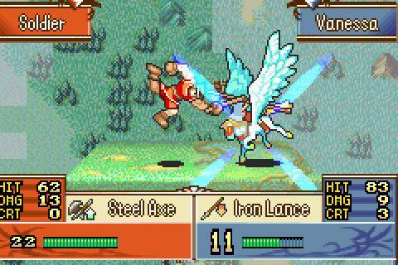
Random Seeds
A seed is a value used to initialize a pseudorandom Random Number Generator (RNG).
For this module, we’ll be using Java.util.Random.
E.g. Given the seed “CS2030”, and being told to generate an integer between 1-100, a RNG may generate this sequence of integers: 90, 60, 79, 44
Every time RNG is initialized with this seed and told how to generate the numbers, it will give the same “random” output every time.
If you change either of these, e.g. “CS2040” as a seed, or numbers between 1-1000, the output will be different.
Keep this in mind while testing.
some games you may be familiar
with that use RNG in this way:

Slide 17
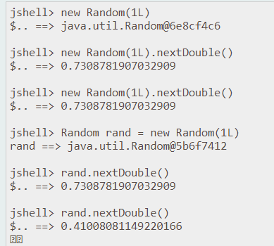
Main Class Update
Fixed Seeds — Every run of the program will have the same randomized outputs.
class Main {
private static final Random RNG_REST = new Random(3L);
private static final Random RNG_REST_PERIOD = new Random(4L);
private static final double SERVER_REST_RATE = 0.1;
static double genRestPeriod() {
return -Math.log(RNG_REST_PERIOD.nextDouble()) / SERVER_REST_RATE;
}
...
double probRest = sc.nextDouble();
Supplier<Double> restTimes = () ->
RNG_REST.nextDouble() < probRest ? genRestPeriod() : 0.0;
...
}

Slide 18
Main Class Update
class Main {
private static final Random RNG_REST = new Random(3L);
private static final Random RNG_REST_PERIOD = new Random(4L);
private static final double SERVER_REST_RATE = 0.1;
static double genRestPeriod() {
return -Math.log(RNG_REST_PERIOD.nextDouble()) / SERVER_REST_RATE;
}
...
double probRest = sc.nextDouble();
Supplier<Double> restTimes = () ->
RNG_REST.nextDouble() < probRest ? genRestPeriod() : 0.0;
...
}
If the new randomized Double from RNG_REST is less than the probability of a rest period…
then, generate a rest time for the Server to take a break.
Else, rest time remains at 0.0, and the Server continues working!
This is like when you try to hit that
70% accurate Focus Blast in Pokémon :)

Slide 19
Lab #5.2: Self-Checkout
Now N self-checkout counters are set up.
All self-checkout counters share the same queue.
Unlike human servers, self-checkout counters do not rest.
When we print out the wait event, we always say that the customer is waiting for the self-checkout counter k + 1, even though this customer may eventually be served by another self-checkout counter.
Hint: Imagine the simulator is a FairPrice supermarket. How does FairPrice self checkout counter works?

Slide 20
Lab #5.2: Main Class Update
class Main {
...
int numOfSelfChecks = sc.nextInt();
Simulator sim = new Simulator(numOfServers, numOfSelfChecks, qmax,
arrivalTimes, serviceTimes, restTimes);
...
}
Now with an additional input
for your test cases!

